Slide 1
EarnEasy: A Mobile Crowdsourcing Application

Slide 2
Team Members
Supervised By
Dr. Md. Shariful Islam
Professor
Institute of Information Technology
University Of Dhaka
Submitted By
Pritom Kumar Das
BSSE 0919

Slide 3
Presentation Outline
Motivation
Problem Description
QFD
Timeline

Slide 4
Mobile Crowdsourcing
Crowdsourcing is a business model or function that relies on a large group of users as third parties for outsourcing certain tasks. Mobile crowdsourcing is using smartphones as the medium of crowdsourcing strategies.

Slide 5
Motivation

Slide 6
Motivation
Enormous potential of mobile crowdsourcing
App development in flutter
Create a platform between user and companies
Research opportunities

Slide 7
Problem Description

Slide 8
Problem Description
Aims to create a application that uses mobile crowdsourcing as its backbone.
Enable a platform to use the vast amount of smartphone users.
Companies will provide tasks and the users can complete them at their leisure.

Slide 9
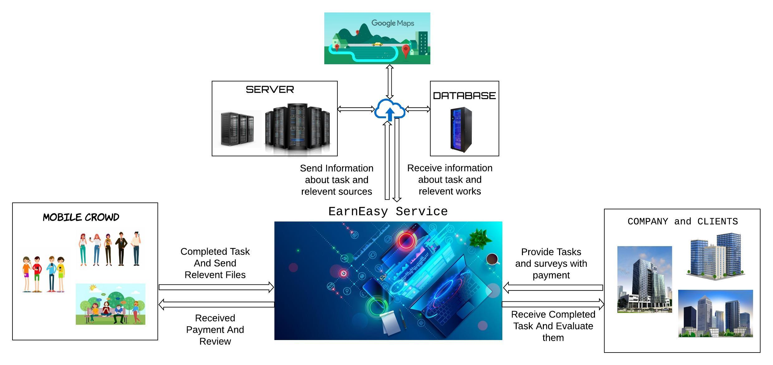
Problem Description

Slide 10
Quality Function Deployment

Slide 11
Quality Function Deployment (QFD)
Normal Requirement
User-Friendly Interface
Accessible via the internet
Allow valid users assign/find tasks.
Sort tasks based on money/distance.
Limit access to the functionality of the system based upon user roles

Slide 12
Quality Function Deployment (QFD)
Expected Requirement
Payment system integration
Error-free software
Map facilities
Super Admin monitors all activities
Provide Search Facilities

Slide 13
Quality Function Deployment (QFD)
Exciting Requirement
Work scheduling based on user merit.
Showing tasks based on zoom level.

Slide 14
Timeline

Slide 15
Weeks | 1 | 2 | 3 | 4 | 5 | 6 | 7 | 8 | 9 | 10 | 11 | 12 | 13 | 14 | 15 | 16
Planning and Requirement Analysis | X | X
Prioritising Requirements |  | X | X | X
Designing Architecture |  |  |  | X | X | X | X | X | X | X
Developing Project and Testing |  |  |  | X | X | X | X | X | X | X | X | X | X | X | X
Review and Retune |  |  |  |  |  |  |  |  |  |  | X | X | X | X | X
Deployment |  |  |  |  |  |  |  |  |  |  |  |  |  |  |  | X
Documentation |  |  | X | X | X | X |  |  |  | X | X | X | X | X | X | X

Slide 16
THANKS!
Any questions?

